Slide 1

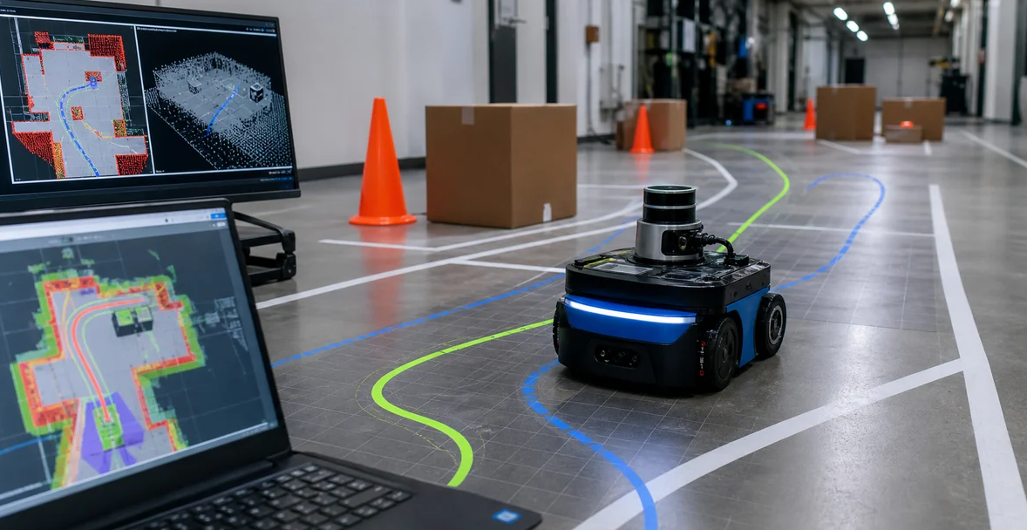
Reinforcement Learning-Based
Autonomous Navigation
Prepared by: Mohammad Osama Twati
Supervisors: Dr. Louay Saleh · Eng. Sara Hamdan

Slide 2
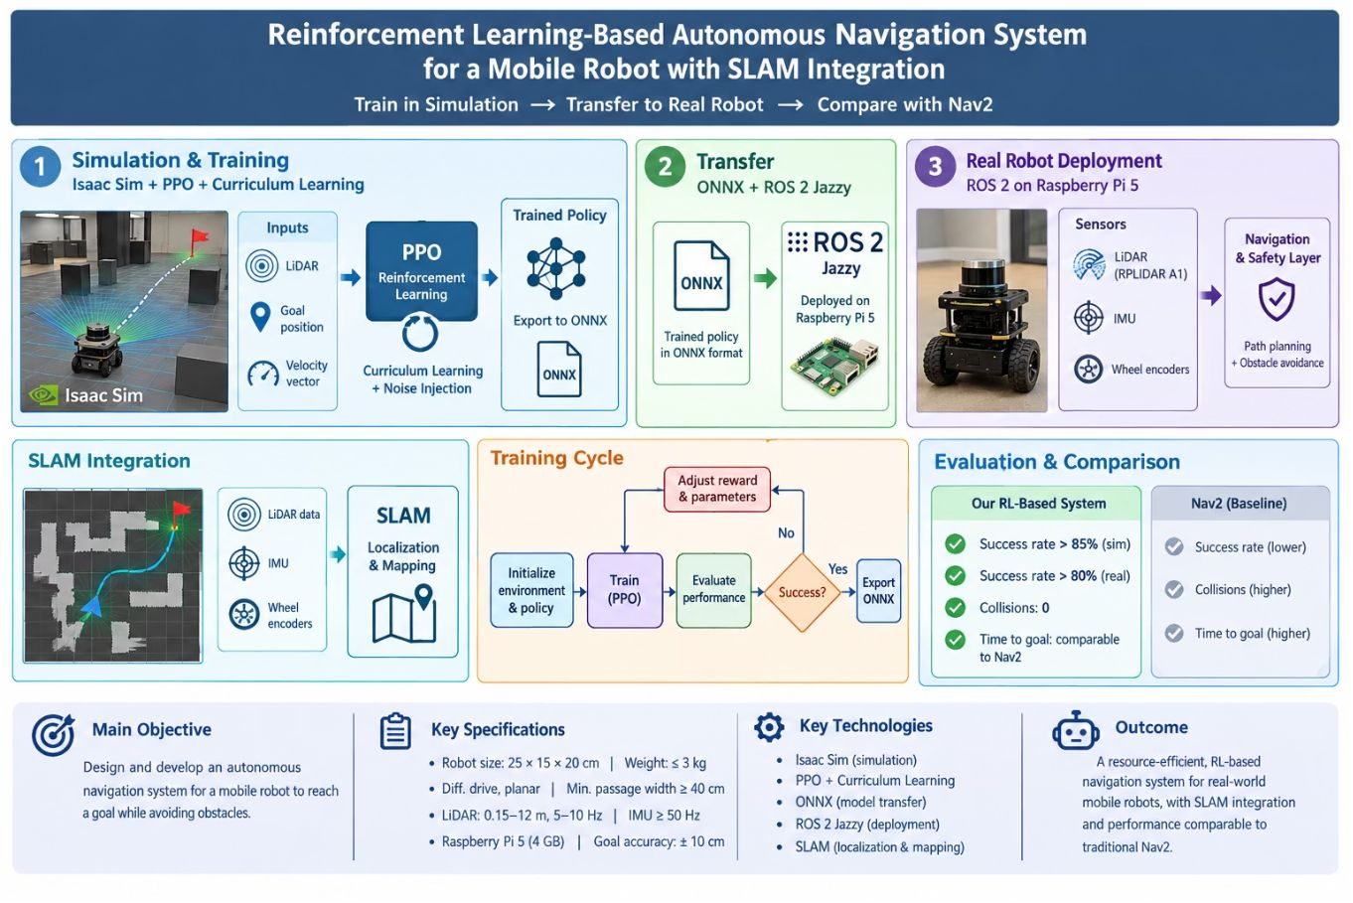


THE MOTIVATION
Why move beyond traditional navigation? One system from simulation to robot
SLAM handles localization and mapping, PPO reinforcement learning drives motion decisions, and ONNX deployment runs inside a ROS 2 Jazzy node.
Nav2
Combines global and local planning, but depends on costmaps and manually tuned parameters.
Reinforcement learning
Learns a navigation policy through trial and error, with potential advantages in narrow or changing environments.
RESEARCH QUESTION
Can a policy trained in Isaac Sim transfer to a resource-constrained Raspberry Pi 5 robot, and how will it compare with Nav2?
2

Slide 3
LITERATURE REVIEW
What recent research tells us
Study | Finding
Taheri et al. (2024) | PPO performed strongly in simple environments, but performance dropped in complex scenes.
Arce Llobera et al. (2026) | Parallel Isaac Sim training reduced training time and collision rates in simulation.
Gao et al. (2025) | Hierarchical RL achieved strong results in a narrow home environment with limited real-world trials.
Salimpour et al. (2025) | Demonstrated sim-to-real transfer, but not a quantitative real-world Nav2 comparison.
Across the literature: simulation is advancing faster than repeatable physical-robot evaluation.
2

Slide 4
LITERATURE COMPARISON
Comparison of the four reviewed studies
Study | Platform | Algorithm | Sensors | Key Results | Limitations
Taheri et al. (2024) | Gazebo | PPO with ResBlocks versus DDPG | LiDAR, 10 compressed measurements | Simple environment: PPO 100% and DDPG 98.46%; complex environment: DDPG 93.65% and PPO 67.81% | Simulation only; small number of evaluation episodes.
Arce Llobera et al. (2026) | Isaac Sim/Lab | PPO with a GRU layer | LiDAR, 128 beams, and IMU yaw angle | 750 robots trained in parallel in about 4 hours; collisions decreased from 24% to 11% in one environment | Simulation only; SLAM uses LiDAR only, without loop closure.
Gao et al. (2025) | Gazebo, then physical TurtleBot3 | D3QN high level and CPO low level | LiDAR and wheel odometry | 97% success in a narrow home environment; collision-free real-world trials | Collisions with pedestrians in dense crowds; few real-world trials: 30 and 10 attempts.
Salimpour et al. (2025) | Isaac Sim, then Gazebo | PPO, MLP and LSTM | LiDAR and odometry | Zero-shot transfer to TurtleBot 4 Lite; success in 7–10 of 10 static-environment trials; comparison with Nav2 in Gazebo | Weak performance with dynamic obstacles; no quantitative real-world comparison with Nav2.
2

Slide 5



PROJECT DEFINITION
The research gap defines this project
Research gap: existing studies report strong simulation results, but few offer repeatable, quantitative real-world comparisons of RL navigation against Nav2 on a low-cost, compute-limited robot.
This project turns that gap into a measurable engineering target.
Primary objective
Secondary objectives
Focus
Develop an autonomous mobile-robot system that reaches a goal while avoiding obstacles.
Integrate SLAM
Train PPO in Isaac Sim
Export the policy to ONNX
Deploy on Raspberry Pi 5
Compare with Nav2
How simulation conditions and sensor noise affect transfer to the physical robot.
5

Slide 6
ENGINEERING CONSTRAINTS
Technical target: a compact, measurable platform
Parameter | Value
Robot dimensions | 25 × 15 × 20 cm
Robot mass | ≤ 3 kg
Drive type | Differential drive
Minimum passage width | ≥ 40 cm
Linear speed | 0.1–0.4 m/s
Angular speed | ≥ 1 rad/s
Goal accuracy | ±10 cm
LiDAR | RPLIDAR A1 · 360° scan · 0.15–12 m · 5–10 Hz
IMU and encoders | IMU ≥ 50 Hz · wheel encoders ≤ 2% distance error
Computing | Raspberry Pi 5 with 4 GB memory
Test environment | Indoor test area of at least 6 × 4 m
5

Slide 7
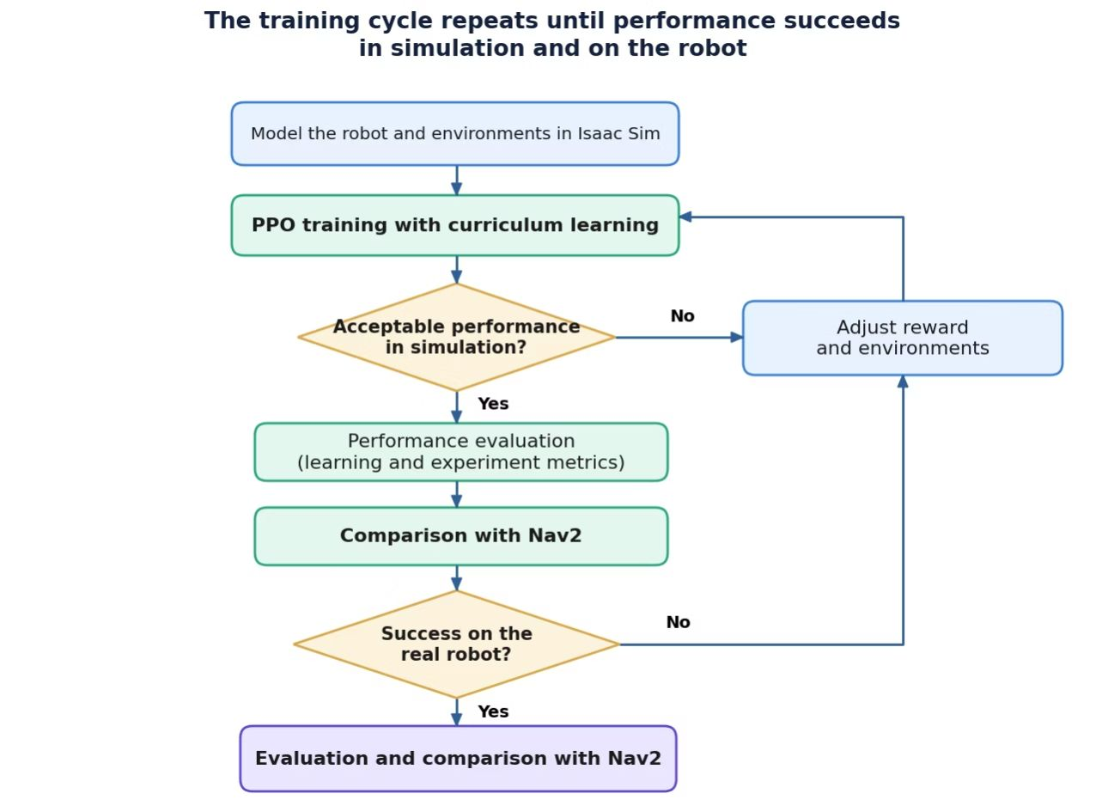
METHOD
Method: train once, iterate until transfer succeeds
Training repeats while reward design, environment diversity, and sensor noise are adjusted until the policy succeeds in simulation and transfers to the robot.
Model the robot, sensors, and diverse environments in Isaac Sim.
Train PPO with curriculum learning and injected sensor noise.
Export the trained policy in ONNX format.
Run the policy in a ROS 2 Jazzy node on Raspberry Pi 5.
Evaluate against Nav2 using repeatable physical-robot tests.
INPUTS LiDAR readings · goal position · robot velocity vector
EVALUATION success rate · collisions · time to goal
LOOP LEVERS reward design · environment diversity · sensor noise · transfer check
7

Slide 8
TIMELINE
Project timeline by phase
PHASE 1
PHASE 2
PHASE 3
PHASE 4
PHASE 5
PHASE 6
1
2
3
4
5
6
Environment setup
ROS 2 Jazzy + Isaac Sim
Literature review
Research gap
Robot modeling
Sensor integration
Simulation environments
Diverse layouts and obstacles
PPO training
ONNX export
Deployment and evaluation
Real robot and Nav2 comparison
Phases run in sequence across the full project; no fixed calendar dates.
7

Slide 9
EVALUATION CRITERIA
Success will be judged quantitatively
85%
80%
0
Nav2
Time to goal: comparable to the Nav2 baseline.
Simulation success rate target: above 85%.
Real-world success rate target: 80%.
Collision target: 0.
The contribution is a repeatable sim-to-real evaluation of RL navigation on a compact robot, not simulation results alone.
9

